Slide 1
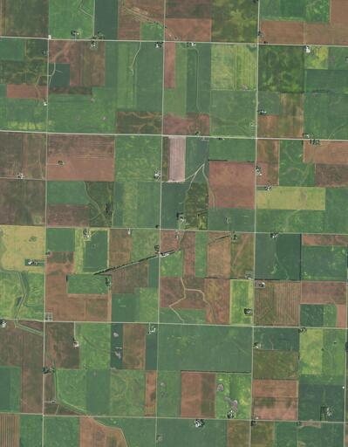


Climate Related Financial Disclosure for Growmark Inc.
Malik Khatib – Business Information Systems
Ryan Krakowiak – Environmental Science and GIS Analytics
Lawrencia Mensah - Agribusiness
Dr. Jim Jones - Mentor
David Lloyd- Growmark Representative
April 6, 2023

Slide 2
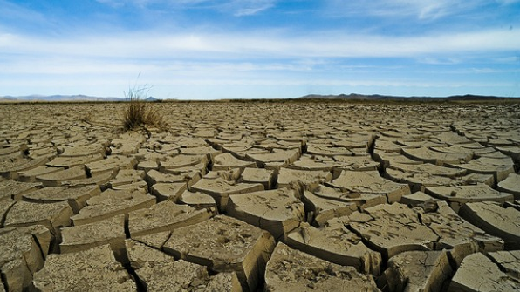
Introduction
The question posed: How is climate change affecting agriculture in the Midwest
This presentation takes a look at how climate change is affecting the agricultural sector as it pertains to Growmark. We used a TCFD format for the project to identify better with the needs of Growmark. We used data to identify shifts in temperature, precipitation, and C02 levels in the next few years. Other indicators in this project include how Growmark can mitigate its risk in these areas and what the cost of that is likely to be.
This Photo by Unknown author is licensed under CC BY.

Slide 3
Background
Increased Temperature | Increased Atmospheric Moisture
Midwest warm season temperatures are estimated to see largest increase in U.S. Late-century estimates predict average temperature increase of five degrees Fahrenheit for RCP 4.5 and as much as eight degrees Fahrenheit in the Midwest (Vose et al. 2017). | Increased Springtime precipitation frequency and intensity Mesoscale Convective Systems (large storms) frequency and intensity perpetuated by warmer Springtime temperatures and are expected to increase with current Midwestern climate predictions (Feng et al. 2016).
Extreme temperatures expected to increase (daily minimum and maximum) Late-century daily minimum and maximum temperatures may rise as much as ten degrees Fahrenheit under human contributed climate change (Sillman et al. 2013). | Precipitation Variability Although generally the Midwest has seen an increase in precipitation, the SPI (Standardized Precipitation Index) magnitude and range has also increased in parts of the Southern Midwest (Ford et al. 2020). This can also be quantified during drought.
Increased evaporation (Drought) The rate of evaporation increases as temperature increases, which can affect both agricultural drought and hydrological drought. Of larger concern to the Midwest would be agricultural drought, where higher temperatures will decrease the amount of moisture in soil (Wehner et al. 2017). | Increased Spring Precipitation (frequency) Projected intensity of the Great Plains Low Level Jet increased, which correlates to an increase in Springtime (April, May, June) rainfall (Cook et al. 2008).
Predictions of Midwest Climate Under Climate Change Models

Slide 4
Strategy C Scenario Analysis
Agricultural Asset | Crop Protection | Crop Nutrients | Crop Harvest
Associated risks under projected climate trends over the next century. | Climate associated risk: Increased annual temperatures (warm and cold season) Potential Outcome: Insects and pests that are traditionally vulnerable in colder months will have increased survivability. Northward expansion of native southern insects and pathogens as Midwest climate conditions become more favorable. (Vigil et al. 2018) Increased growing season window, warmer temperatures in Springtime create optimal planting conditions earlier. | Climate associated risk: Increased warm season precipitation frequency and intensity Potential Outcome: Increased soil erosion, possible water-logged soil, which will affect the health of crops and reduce number of available workdays in the field. Climate associated risk: Warm, saturated air can hold more water, causing drought Potential Outcome: Heat stress and insufficient water can lead to significantly reduced crop yield (USDA 2013). | Climate associated risk: Increased humidity, high moisture conditions Potential Outcome: Stored grain pests that favor high-humid environments will be more suited to Midwest predicted climate conditions. Mold, toxins more prevalent in late growing season

Slide 5
Growing Degree Days
Project number of grow days throughout the 21st century using the RCP 4.5 Scenario (Emissions peak around 2040 and decline afterwards) in the Midwest region.
Note that 2700 growdays are most optimum for Corn Harvest.
Impacts of climate variability and adaptation strategies on crop yields and soil organic carbon in the US Midwest - Agricultural & Environmental Science Collection - ProQuest
Wang et al. 2016
Mahony et al. 2022

Slide 6
Growing Degree Days
Project number of grow days throughout the 21st century using the RCP 8.5 Scenario (Emissions continue to rise throughout the 21st century, most notable difference occurring after 2050) in the Midwest region. ​
​
Note that 2700 growdays are most optimum for Corn Harvest.
Wang et al. 2016
Mahony et al. 2022

Slide 7
Site Suitability Model
Projected area of Optimal land for Corn and Soybean growth weighing RCP 4.5 Scenario predictions of daily minimum temperatures during Spring and Summer, maximum temperatures during Summer, average temperatures during Spring and Summer, and rainfall during spring and summer. Rail lines are overlayed to further determine optimality when analyzing future markets.
Wang et al. 2016
Mahony et al. 2022

Slide 8
Site Suitability Model
Projected area of Optimal land for Corn and Soybean growth weighing RCP 8.5 Scenario predictions of daily minimum temperatures during Spring and Summer, maximum temperatures during Summer, average temperatures during Spring and Summer, and rainfall during spring and summer. Rail lines are overlayed to further determine optimality when analyzing future markets.
Wang et al. 2016
Mahony et al. 2022

Slide 9
Top risks
Risk drivers | Changes in temperature and precipitation | Regulatory Changes
Type | Physical | Transition
Scale | High | High
Likelihood | Very likely | Very likely
Timeframe | Long-term (30-year) | Long-term (30-year)
Impact | Unpredictability and fluctuation in grow window and percent yield | The implementation of stricter environmental regulations and policies aimed at reducing greenhouse gas emissions and promoting sustainable agricultural practices
Financial implications | These unpredictable climate conditions may require the use of new technologies, R&D, Repairs, Training, etc | Changing regulatory policies can lead to increased compliance costs, operational adjustments, and altered market dynamics for agricultural companies like Growmark. These changes may necessitate investment in low-carbon technologies and could result in stranded assets, impacting the company's financial performance and position.
Quantifications | 754 Million USD | 528 Million USD
Methodology | Estimated potential financial impact is annualized over a 30-year time horizon of estimated R&D costs and negative revenue impacts. Assuming over a 30-year period, agriculture-based companies spend 10% of revenue on innovations, based on open source data this is how much Growmark would be expected to spend. | Estimated potential financial impact is annualized over a 30-year time horizon, calculated using data based on what other agriculture companies are spending on regulatory changes per year

Slide 10
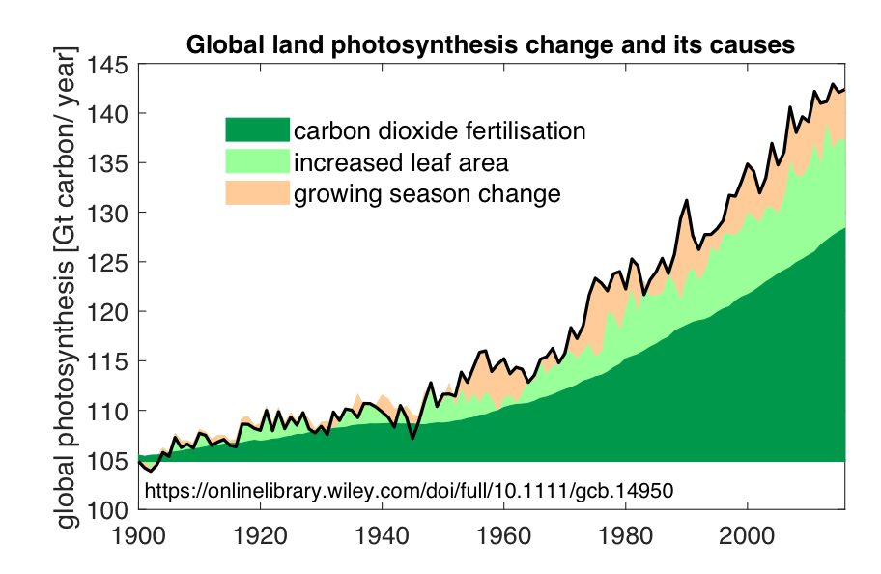
Climate Condition | Impact on financial performance
Increased CO₂emission | Increase in Revenue from the new product Growmark can sell (Carbon Capture Storage)
 | Growmark could take advantage of the excess CO₂ they release into the environment due to the heavy machines they use on their site. They can look at capturing carbon dioxide and injecting it into deep geologic formations for safe, secure and permanent storage. This will help Growmark achieve climate goals and help mitigate CO₂ emissions
 | Increased crop production for farmers
 | Jaggar et al. (2010) concluded that CO₂ enrichment was likely to allow yield increases depending on the location. Rising levels of CO₂ in the atmosphere drive an increase in plant photosynthesis—an effect known as the carbon fertilization effect. New research has found that between 1982 and 2020, global plant photosynthesis grew 12%, tracking CO₂ levels in the atmosphere as they rose 17%. Most of this increase in photosynthesis was due to carbon dioxide fertilization Elevated CO2 levels, above-ground plant growth increased an average of 21%, while below-ground growth increased 28%. As a result, some crops such as wheat, rice and soybeans are expected to benefit from increased CO2 with an increase in yields from 12 to 14 percent. However, crops such as corn are not affected

Slide 11
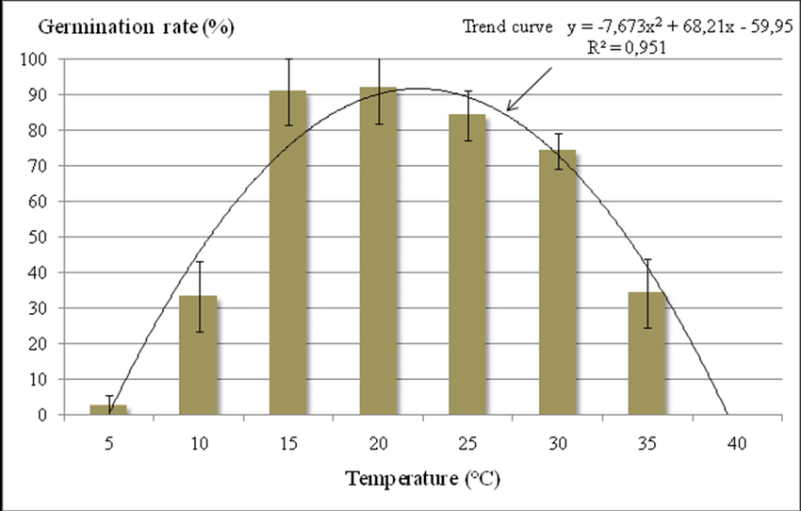
Climate Condition | Impact on financial performance
Increased temperatures | Decrease in the quality and quantity of seed, business interruption
 | High temperatures during seed filling frequently disrupt normal seed development, which increases the proportion of seeds that are shriveled, abnormal and are of lower quality (Spears et al. Reference Spears, Tekrony and Egli1997) Many crops start to experience stress at temperatures above 32° to 35°C. Models show that each degree of added warmth can cause a 3% to 7% loss in the yields of some important crops, such as corn and soybeans
 | Decrease in the demand of fertilizer usage You do need to reduce the amount of fertilizer to 20% you would normally use during high temperature. This will protect the plant from fertilizer burn. You also need to give the plant plenty of water after adding the fertilizer

Slide 12
Climate Condition | Impact on financial performance
Warming Winters and Increased Atmospheric Moisture | Increased cost: High demand for insecticides, weedicides
Warming Winters and Increased Atmospheric Moisture | Warmer winters and a longer growing season also help the pests, pathogens, and invasive species that harm vegetation During longer growing seasons, more generations of pests can reproduce as warmer temperatures speed up insect life cycles, and more pests and pathogens survive over warm winters. Rising temperatures are also driving some insects to invade new territories Higher temperatures and an increase in moisture also make crops more vulnerable. Weeds, many of which thrive in heat and elevated CO₂, already cause about 34% of crop losses; insects cause 18% of losses, and disease 16%. Climate change will likely magnify these losses

Slide 13
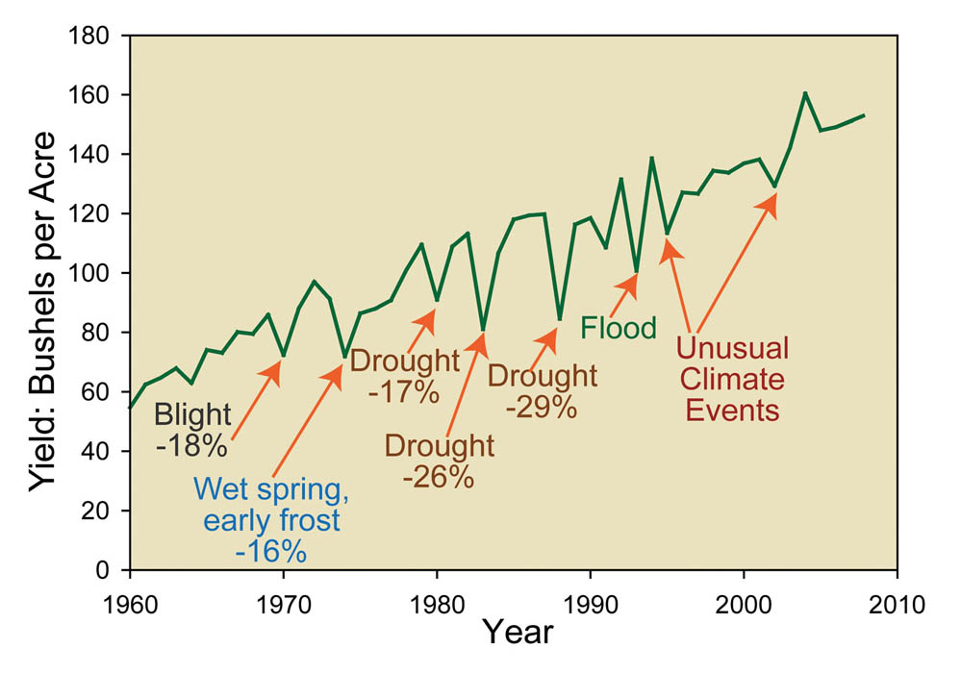
Climate Condition | Impact on financial performance
Increased evaporation (drought) | Increased evaporation drought
 | Drought stress during the vegetative period can cause a reduced growth rate, prolong the vegetative growth stage, redirect the roots and alter the carbohydrate distribution in maize seeds. Short-duration water deficits have been shown to cause 28–32% losses of dry weight during the rapid vegetative growth stage and 66–93% losses of dry weight during the tasseling and ear formation stages, respectively long-term drought (21 days) during the pre-flowering stage has been shown to reduce the final sizes of certain leaves and internodes, delay tassel and silk emergence, and cause yield losses from 15 to 25%

Slide 14
Financial impacts (Generalized)
Impact on financial performance | Growmark is using the latest technologies for their grain marketing in order to provide the most efficient operations and strategic partnerships. Paired with their high-level logistics that include brokerage services and leading crop nutrients, they're able to increase revenue in times when climate impact is semi-predictable Growmark faces increased costs due to climate-related factors such as carbon pricing policies, business interruptions, contingency planning, and repairs. Carbon pricing policies may raise costs related to direct and indirect emissions, while extreme weather events can disrupt operations and affect crop yields. Contingency planning and risk management efforts to address climate uncertainties also contribute to increased costs. Additionally, climate-related events may damage infrastructure and equipment, necessitating expensive repairs or replacements Agricultural companies like Growmark can experience changes in operating cash flow due to factors such as commodity price fluctuations, sustainable sourcing, regulatory compliance, and water and energy costs. Climate-related events can impact commodity prices while prioritizing sustainability and environmentally-friendly practices may increase costs. New regulations for greenhouse gas emissions or sustainable agriculture can raise compliance expenses, and climate-related factors may affect water and energy costs. These changes in upstream costs can directly impact the operating cash flow of agricultural companies Growmark may face changes in total expected losses due to physical risks associated with climate change, such as crop yield losses, supply chain disruptions, and increased insurance premiums. Extreme weather events can negatively impact crop yields, affecting Growmark's financial performance and leading to higher total expected losses. Climate-related risks can also disrupt the supply chain, causing increased costs and operational inefficiencies. Additionally, as climate-related events become more frequent and severe, insurance premiums may rise, increasing Growmark's operating costs and contributing to higher total expected losses
Impact on financial position | Growmark's expected portfolio value can be influenced by market opportunities, operational efficiency, regulatory changes, and transition risks. By tapping into the growing demand for sustainable products and services and improving operational efficiency through eco-friendly practices, Growmark can positively impact its portfolio value. However, regulatory changes and transition risks may present challenges that could negatively affect the portfolio value. Proactively managing these factors can help Growmark maintain competitiveness and drive growth in the agricultural sector Growmark's low-carbon capital investments can increase assets, improve operational efficiency, reduce emissions, and help the company adapt to regulatory changes. While these investments may initially raise liabilities, they can ultimately enhance equity through cost savings and new revenue streams

Slide 15
References
Cook, K. H., E. K. Vizy, Z. S. Launer, and C. M. Patricola, 2008: Springtime intensification of the Great Plains low-level jet and midwest precipitation in GCM simulations of the twenty-first century. Journal of Climate, 21 (23), 6321–6340. doi:10.1175/2008jcli2355.1.
Feng, Z., L. R. Leung, S. Hagos, R. A. Houze, C. D. Burleyson, and K. Balaguru, 2016: More frequent intense and long-lived storms dominate the springtime trend in central
Ford, T. W., Chen, L., & Schoof, J. T. (2021). Variability and transitions in precipitation extremes in the midwest united states. Journal of Hydrometeorology, 22(3), 533-545. doi:https://doi.org/10.1175/JHM-D-20-0216.1
Khan, A. Z., Shah, P., Khan, H., Nigar, S., Perveen, S., Shah, M. K., ... & Zubair, M. (2011). Seed quality and vigor of soybean cultivars as influenced by canopy temperature. Pak. J. Bot, 43(1), 642-648
Mahony, C.R., T. Wang, A. Hamann, and A.J. Cannon. 2022. A global climate model ensemble for downscaled monthly climate normals over North America. International Journal of Climatology. 1-21. https://doi.org/10.1002/joc.7566
Sillmann, J., V. V. Kharin, F. W. Zwiers, X. Zhang, and D. Bronaugh, 2013: Climate extremes indices in the CMIP5 multimodel ensemble: Part 2. Future climate projections. Journal of Geophysical Research: Atmospheres, 118, 2473–2493, doi:10.1002/jgrd.50188.
USDA. “United States Department of Agriculture.” Crop Production Down in 2012 Due to Drought, USDA Reports Winter Wheat Seedings and Grain Stocks Are Also Reported, 11 Jan. 2013, https://www.nass.usda.gov/Newsroom/archive/2013/01_11_2013.php.
US rainfall. Nature Communications, 7, 13429. doi:10.1038/ncomms13429
Vigil, S. L., Ruder, M. G., Shaw, D., Wlodkowski, J., Garrett, K., Walter, M., & Corn, J. L. (2018). Apparent range expansion of 0RW1S34RfeSDcfkexd09rT2culicoides (hoffmania) insignis1RW1S34RfeSDcfkexd09rT2 (diptera: Ceratopogonidae) in the southeastern united states. Journal of Medical Entomology, 55(4), 1043-1046. doi:https://doi.org/10.1093/jme/tjy036
Vose, R. S., D. R. Easterling, K. E. Kunkel, A. N. LeGrande, and M. F. Wehner, 2017: Temperature Changes in the United States. Climate Science Special Report: Fourth National Climate Assessment, Volume I. Wuebbles, D. J., D. W. Fahey, K. A. Hibbard, D. J. Dokken, B. C. Stewart, and T. K. Maycock, Eds., U.S. Global Change Research Program, Washington, DC, USA, 185–206. doi:10.7930/J0N29V45
Wang, T., A. Hamann, D. Spittlehouse, C. Carroll. 2016. Locally Downscaled and Spatially Customizable Climate Data for Historical and Future Periods for North America. PLoS One 11(6): e0156720 https://doi.org/10.1371/journal.pone.0156720
Wehner, M. F., J. R. Arnold, T. Knutson, K. E. Kunkel, and A. N. LeGrande, 2017: Droughts, Floods, and Wildfires. Climate Science Special Report: Fourth National Climate Assessment, Volume I. Wuebbles, D. J., D. W. Fahey, K. A. Hibbard, D. J. Dokken, B. C. Stewart, and T. K. Maycock, Eds., U.S. Global Change Research Program, Washington, DC, USA, 231–256. doi:10.7930/J0CJ8BNN.
Bank, N.C. (2022) The NCB co-op 100® reports top producing cooperatives with revenues of $255 billion, National Cooperative Bank. Working Together. Building Community. Available at: https://www.ncb.coop/press-releases/the-ncb-co-op-100-reports-top-producing-cooperatives-with-revenues-of-255-billion (Accessed: April 13, 2023).

